Slide 1

Machine Learning

Slide 2
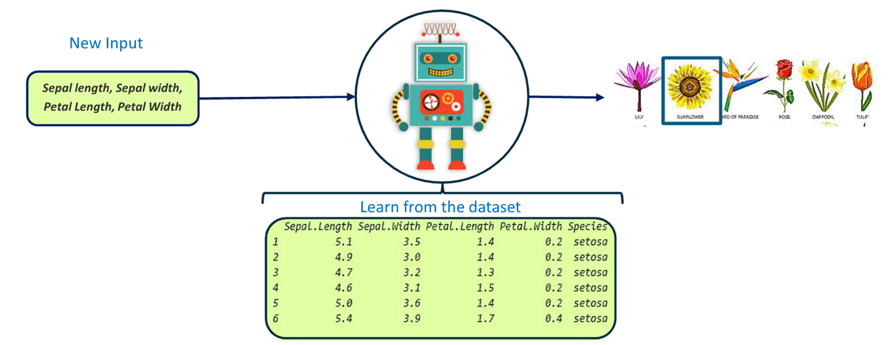
Machine Learning
Machine Learning is a type of Artificial Intelligence (AI) that provide computers with the ability to learn without being explicitly programmed.
Example: To determine the species of the flower with given data.
.
Problem statement : Determine the species of the flower.

Slide 3
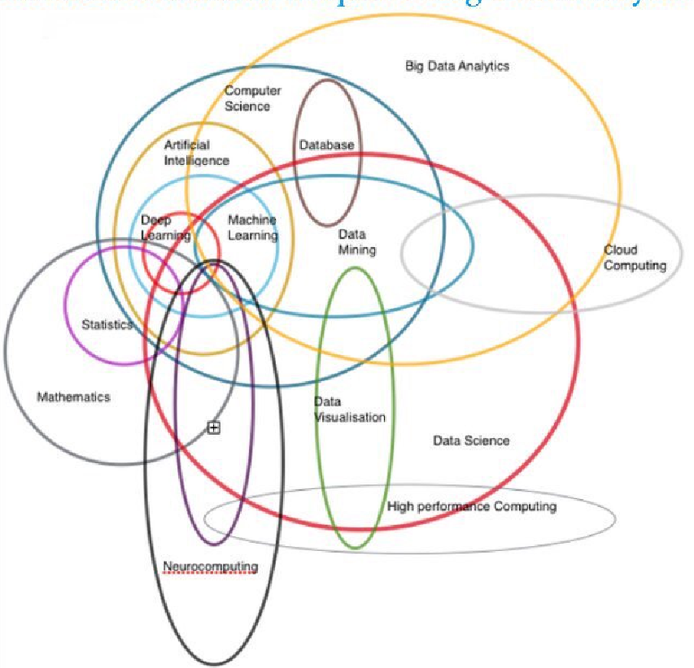
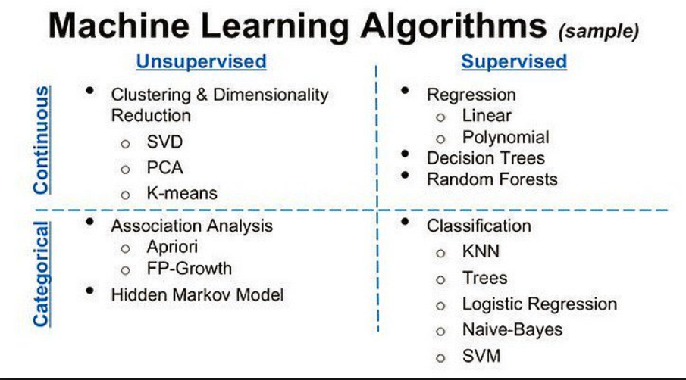
Overview of Machine Learning
Machine Learning Field overlap

Slide 4
Types of Machine Learning

Slide 5
Types of Machine Learning
Machine Learning has been classified into Three types
Supervised Learning
Unsupervised Learning
Reinforcement Learning

Slide 6





Supervised Learning
When machine classifies the data into predefined classes, then it is called Supervised Learning.
Supervised learning is where we have input variables (X) and an output variables (Y) and an algorithm is used to learn mapping function from the input to the output.
Step 1 - Training
Learning Algorithms
Training Data
Step 2 - Testing
Test Data
Accuracy
Model

Slide 7
Types of Supervised Learning
Regression
Supervised Learning
Classification

